Slide 1
Social Network Analysis
Basic Methods for Analyzing Networks
Prof. Keeheon Lee
TA. Jaekeun Lee
010-5599-9411
agdal1125@gmail.com

Slide 2
Table of Contents
Graphs & Matrices
Relationship Measures
Centrality and Prestige
Cliques
Structural Equivalence
Visual Displays
Blockmodels

Slide 3
1. Graphs & Matrices
Social network data can be represented and analyzed in two major methods: graphs and matrices
 | A | B | C | D | E
A | 0 | 1 | 0 | 1 | 0
B | 1 | 0 | 1 | 0 | 1
C | 0 | 1 | 0 | 1 | 0
D | 1 | 0 | 1 | 0 | 1
E | 0 | 1 | 0 | 1 | 0
A
B
E
C
D
Graph
Matrix
Present visualizations of social networks
Mathematical algebraic representations of network relations
Provide more forceful visual illustrations of network structure
Do not support mathematical manipulations
Facilitate sophisticated mathematical and computer analysis of the network
Less user-friendly

Slide 4
1. Graphs & Matrices Graphs
The idea of implementing graphs to social network data originated from Jacob Moreno’s (1934) sociogram
Sociogram:
Two-dimensional diagram for displaying the relations among actors in a bounded social system.
(ex. Elementary school classroom)
In sociogram or graph, actors are represented by set of N (number of actors) points (also called vertices / nodes)
A line (also called an arc or edge) is drawn between a pair of points to indicate a relation or tie.
Absence of line = no direct relations.
The arrowhead symbolizes direction. If a line has no arrowhead, the relation is non-directed or mutual.
If it does, the graph is a directed graph or digraph
The thickness of graph indicates strength of relationship
The two nodes are adjacent , if a line exists between them
A node is incident to a line (and vice versa), if it is one of the two nodes defining the line.

Slide 5
1. Graphs & Matrices Graphs
Subgraph:
A subset of nodes and lines within a larger graph
Walk:
Alternating sequence of incident nodes and lines (ex. The triad (Tom,Betty,Jane))
Walk Length:
Number of lines a walk contains (ex. The walk Jane-Tom-Betty-Harry-Dick-Sally has length 5)
Trail:
Walk that consist of distinct lines, although some nodes may be visited more than once
Circuit:
Trail that starts and ends at the same node. (ex. Dick, Sally, Harry, Tom, Betty, Harry, Dick)
Path:
Walk with entirely distinct nodes and lines.
In digraphs, all arrow must point same direction
Sally
Harry
Tom
Path distance:
Length of path
Jane
Connected
/ Disconnected
If path exist between every pair of nodes
/If not
Mary
Dick
Betty
Strongly connected
/ Unilaterally connected
/ Weakly connected
Every pair of nodes is connected by directed paths in both direction
All pairs of nodes are connected by paths in one direction but not the other direction
All pairs of nodes are joined by lines, disregarding direction
Isolate
Node with no connection

Slide 6
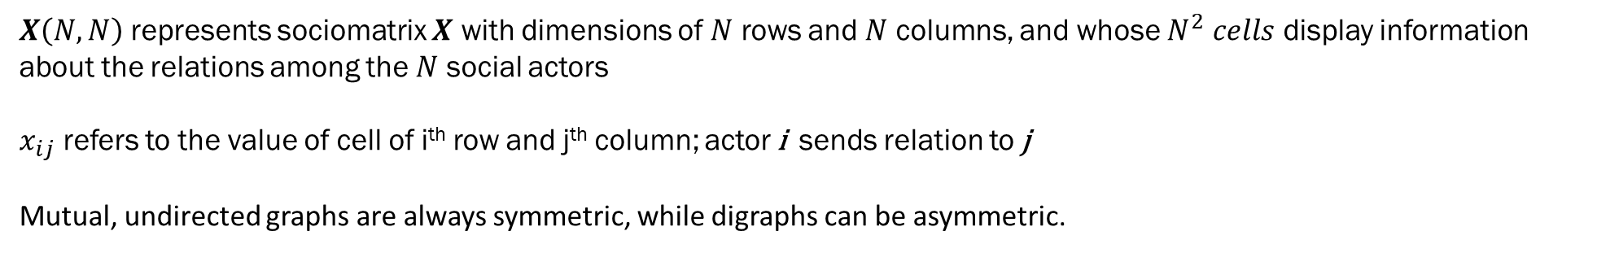
1. Graphs & Matrices Matrices
An algebraic representation of network relations can express all the quantitative information embedded in a sociogram.
The basic form of social network data for mathematical analysis is a tabular display called sociomatrix or adjacency matrix
$X\left(N,N\right)$ represents sociomatrix $X$ with dimensions of $N$ rows and $N$ columns, and whose $N^{2} cells$ display information about the relations among the $N$ social actors
$x_{ij}$ refers to the value of cell of i^{th} row and j^{th} column; actor i sends relation to j
Mutual, undirected graphs are always symmetric, while digraphs can be asymmetric.
Sally
Harry
Tom
 | Sally | Harry | Tom | Jane | Betty | Dick | Mary
Sally | 0 | 1 | 0 | 0 | 0 | 1 | 0
Harry | 1 | 0 | 1 | 0 | 1 | 0 | 0
Tom | 0 | 1 | 0 | 1 | 1 | 0 | 0
Jane | 0 | 0 | 1 | 0 | 1 | 0 | 0
Betty | 0 | 1 | 1 | 1 | 0 | 0 | 0
Dick | 1 | 0 | 0 | 0 | 0 | 0 | 0
Mary | 0 | 0 | 0 | 0 | 0 | 0 | 0
Jane
Mary
Dick
Betty

Slide 7
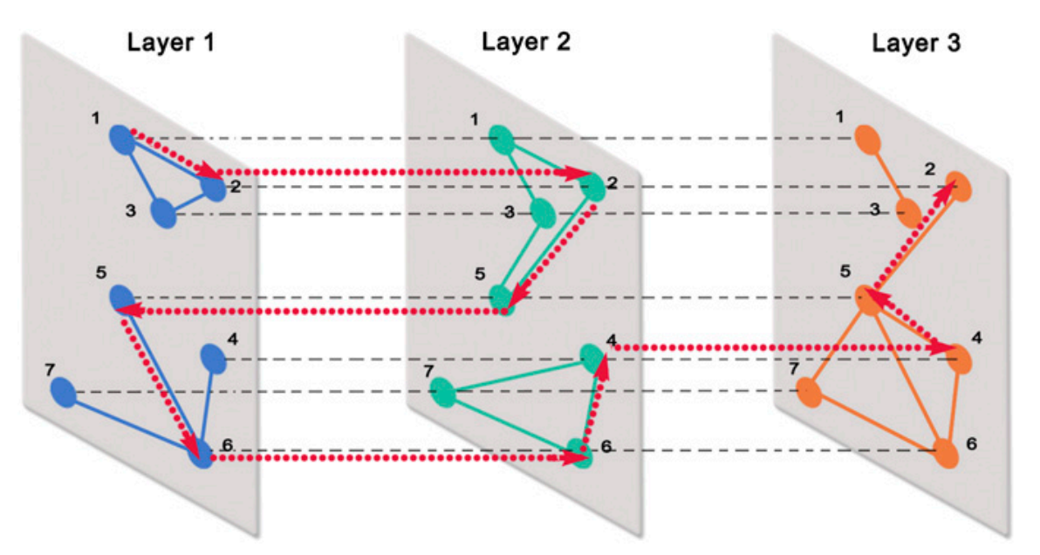
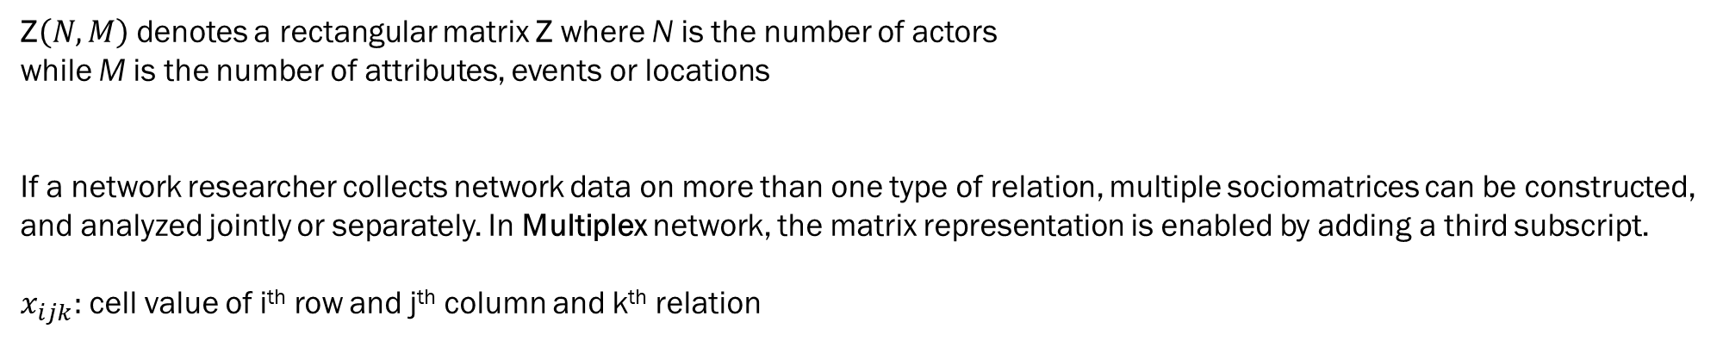
1. Graphs & Matrices Matrices
Sometimes, network researchers use non square matrices to indicate actor attributes or their participation in certain events.
Z$\left(N,M\right)$ denotes a rectangular matrix Z where N is the number of actors
while M is the number of attributes, events or locations
If a network researcher collects network data on more than one type of relation, multiple sociomatrices can be constructed,
and analyzed jointly or separately. In Multiplex network, the matrix representation is enabled by adding a third subscript.
$x_{ijk}:$ cell value of i^{th} row and j^{th} column and k^{th} relation
Multiplex Network

Slide 8
2. Relationship Measures
Social Network Data is distinguished along two dimensions: Directionality and Valuation
Directionality
Nondirected relations
Directed relations
Many non-directed networks may be inherently directed, because the data does not fully consider subjective beliefs, attitudes of the individual actors
Valuation
Binary ( 0 or 1)
Valued Scale (weighted, quantified, continuous, ordinal)
 |  | Directionality
 |  | Nondirected | Directed
Valuation | Binary | Demand least information from informants. Require one member of a dyad to indicate presence of a tie | Require both persons to mention the presence of a tie
 | Valued Scale | Require one person to quantify the relation between both members | Need the most information. Two reports of the magnitude of dyadic relations.

Slide 9
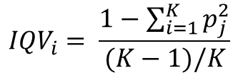

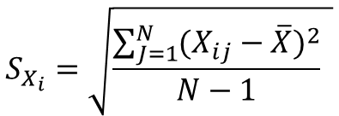
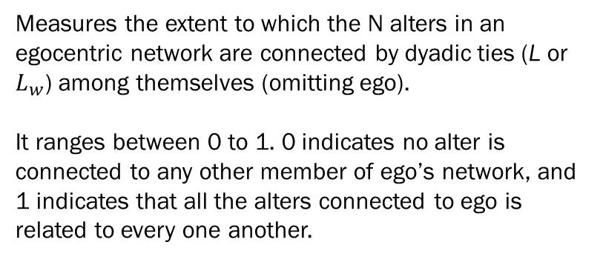



2. Relationship Measures
Egocentric Network Measures
Density (D)
Measures the extent to which the N alters in an egocentric network are connected by dyadic ties (L or $L_{w}$) among themselves (omitting ego).
It ranges between 0 to 1. 0 indicates no alter is connected to any other member of ego’s network, and 1 indicates that all the alters connected to ego is related to every one another.
If binary nondirected: $D=\frac{L}{\left({2 \atop N}\right)}$ , where $\left({2 \atop N}\right)$ = $\frac{N!}{2!×\left(N−2\right)!}$
If binary directed: $D=\frac{L}{2 ×\left({2 \atop N}\right)}$ , where $\left({2 \atop N}\right)$ = $\frac{N!}{2!×\left(N−2\right)!}$
If valued nondirected: $D=\frac{L_{w}}{\left({2 \atop N}\right)}$ , where $\left({2 \atop N}\right)$ = $\frac{N!}{2!×\left(N−2\right)!}$
If valued directed: $D=\frac{L_{w}}{2 ×\left({2 \atop N}\right)}$ , where $\left({2 \atop N}\right)$ = $\frac{N!}{2!×\left(N−2\right)!}$
If alter characteristic is continuous:
Standard Deviation
Network Range
The extent to which an actor’s network links it to diverse other actors, Several empirical indicators such as network size, density, network diversity is used to measure network range.
In egocentric network, network diversity measures the extent of heterogeneity of social characteristics of the alters in an ego’s network.
$$S_{X_{i}}=\sqrt{\frac{\sum_{J=1}^{N}{{(X_{ij}−\overline{X})}^{2}}}{N−1} }$$
If alter characteristic is categorical:
Index of qualitative variation
$${IQV}_{i}= \frac{1−\sum_{i=1}^{K}{p_{j}^{2}}}{(K−1)/K}$$

Slide 10

2. Relationship Measures
Complete Network Measures
Density (D)
If binary nondirected: $D=\frac{L}{\left({2 \atop N}\right)}$ , where $\left({2 \atop N}\right)$ = $\frac{N!}{2!×\left(N−2\right)!}$
In contrast to ego-centric network, where respective actors yield their own density values, in a complete network, there is only one single density value for the whole group. For N actors in a network, the density calculation follows:
If binary directed: $D=\frac{L}{2 ×\left({2 \atop N}\right)}$ , where $\left({2 \atop N}\right)$ = $\frac{N!}{2!×\left(N−2\right)!}$
If valued nondirected: $D=\frac{L_{w}}{\left({2 \atop N}\right)}$ , where $\left({2 \atop N}\right)$ = $\frac{N!}{2!×\left(N−2\right)!}$
If valued directed: $D=\frac{L_{w}}{2 ×\left({2 \atop N}\right)}$ , where $\left({2 \atop N}\right)$ = $\frac{N!}{2!×\left(N−2\right)!}$
Nodal Degree ($d\left(N_{i}\right)$ )
Total number of relations of the i^{th} actor. In a directed network, The nodal degree is distinguished into indegree and outdegree. Indegree is received relation, while outdegree is relation sent.
ex) A’s outdegree = 1, B’s indegree = 2
A
B
Geodesic Distance
C
Length of the shortest path between two actors. It is used to map the communication routes among a set of actors, or observe the flow of information

Slide 11
3. Centrality and Prestige
The concepts that will be introduced are used to quantify graph theoretic ideas about
an actor’s prominence within a complete network by summarizing structural relations among all nodes.
(actor) Degree Centrality : C_{D}(N_{i})
The extent to which a node connects to all other nodes in a social network.
Normalized (actor) Degree Centrality: C_{D}(N_{i})
Eliminate the effect of variation in network size on degree centrality by normalizing it. It divides degree centrality by maximum
number of connections. Closer it approaches to 1, the greater the actor’s involvement in that network.
(group) Degree Centrality : C_{D}
The extent to which the actors in a social network differ from one another in their individual degree centralities.
The sum of the observed differences in degree centralities between actor with largest centrality and the other nodes,
divided by the maximum possible sum of differences

Slide 12
3. Centrality and Prestige
The concepts that will be introduced are used to quantify graph theoretic ideas about
an actor’s prominence within a complete network by summarizing structural relations among all nodes.
(actor) Closeness Centrality: C_{C}(N_{i})
How near a node is to other nodes in a social network. It is computed as the inverse of the sum of geodesic distances
between actor i and all other nodes. The closeness centrality cannot be measured for an isolated nodes
since the denominator cannot be 0. Thus, the graph should be connected.
Normalized (actor) Closeness Centrality: C_{C}(N_{i})
Multiplies the Closeness Centrality by (total number of nodes – 1) to control the size of the network.
This enables comparison of actors across different networks
(group) Closeness Centrality: C_{C}
Measures the dispersion that indicates the hierarchy of closeness centrality within the network.
The closer it gets to 1, the more uneven the distribution of actors closeness centrality is.

Slide 13
3. Centrality and Prestige
The concepts that will be introduced are used to quantify graph theoretic ideas about
an actor’s prominence within a complete network by summarizing structural relations among all nodes.
(actor) Betweenness Centrality: C_{B}(N_{i})
How other actors control of mediate the relations between dyads that are not directly connected. It measures the extent to which
other actors lie on geodesic path (shortest distance) between pairs of actors in the network. It is an important indicator of control
over information exchange or resource.
Normalized (actor) Betweenness Centrality: C_{B}(N_{i})
Divides the Betweenness Centrality by its maximum theoretical value, which is the total number of pairs of nodes.
(group) Betweenness Centrality: C_{B}(N_{i})
Sum of the differences in betweenness centrality scores for the actor with the highest value and every other actor,
divided by maximum possible value of betweenness centrality for all nodes in a network.
In a network where every node has the same betweenness centrality, the value will be 0. If there is a single dominant actor sitting on
all geodesic paths, the value will reach 1

Slide 14
3. Centrality and Prestige
The concepts that will be introduced are used to quantify graph theoretic ideas about
an actor’s prominence within a complete network by summarizing structural relations among all nodes.
Prestige
Prestige is defined as the extent to which a social actor in a network “receives” or “serves as the object” of relations sent by others in the network. It can be measured by counting the number of directed ties that an actor receives from the other network actors for a specified relation.
Actor Degree Prestige:
P_{D}(N_{i})
Calculated as the indegrees of a digraph.
Standardized Actor Degree Prestige:
P_{D}(N_{i})
Actor degree prestige divided by the maximum value of indegree. If the value reaches 1, it indicates all the other actors nominate actor i. If 0, no one nominates actor i.

Slide 15
3. Centrality and Prestige
Centralities in Ego-centric Networks
Degree Centrality:
Number of alters. If standardized, it will be 1
Closeness Centrality:
Inverse of the number of alters. If standardized, it will be 1
Betweenness Centrality:
Egocentric betweenness centrality can exaggerate ego node’s betweenness centrality because it might overlook another node outside the egocentric network. However, if information of the complete network is difficult to obtain, Egocentric betweenness centrality can be a reliable substitute.

Slide 16

4. Cliques
Cohesion
Cohesion refers to the strength of density or intimate relations among members embedded in a social group or closed social circle. Cohesive subgroup consists of actors connected through many directed, reciprocated choice relations with few or no ties to outsiders.
4 General properties in cohesive subgroups:
Mutuality of ties
Reachability of subgroup members
Frequency of ties among members
Relative frequency of ties among subgroup members in comparison to non-members

Slide 17
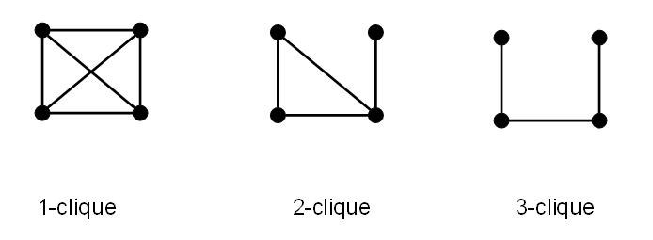
4. Cliques
A
Cliques
Clique is a maximal complete subgraph of three or more nodes, all of which are directly connected to one another.
The geodesic distance for every pair of nodes in a clique is 1.
The clique criteria impose very strict conditions, because even an absence of a tie would prevent a subgraph from being a clique. The difficulty and reliability in data collection makes it even more harder to find cliques in a real world data.
E
B
F
D
C
ex) ABE and BCDE are cliques.
BCE, BDE, BCD, CDE are NOT cliques (it is not maximal)
n - cliques
In n-clique, maximum geodesic distances between all pairs is path length n

Slide 18
4. Cliques
A
Digraph Clique
In a directed network, reciprocity of dyadic ties is required to fit the definition of clique. In short, all pairs of nodes should be connected reciprocally (mutually).
E
B
F
D
C
Digraph n - cliques
ex) Only ABE, BDE, BCD are cliques.
BCDE is NOT a clique (E,C are not mutually connected)
In digraph, there are four types of n-cliques:
Weakly n-connected
Unilaterally n-connected
Strongly n-connected
Recursively n-connected
when the path from node i to j uses the same nodes and edges as the path from j to i in reverse order

Slide 19
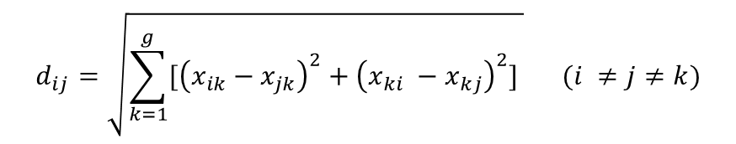
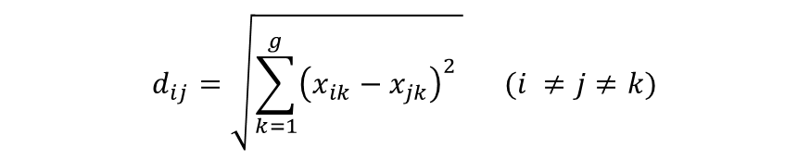
5. Structural Equivalence
Structural Equivalence
Structural equivalence method are used to understand competitive relations. In a directed graph
Structurally equivalent is defined as having exactly identical patterns of ties sent to, and received from all the other network actors.
When determining the structural equivalence of two nodes, the presence of relation between them are irrelevant
Calculation of Structural Equivalence (based on relational similarity in Euclidean distance)
$$d_{ij}=\sqrt{\sum_{k=1}^{g}{{\left(x_{ik}−x_{jk}\right)}^{2}} } (i ≠j≠k)$$
$$d_{ij}=\sqrt{\sum_{k=1}^{g}{[{\left(x_{ik}−x_{jk}\right)}^{2}+{\left(x_{ki} −x_{kj}\right)}^{2}]} } (i ≠j≠k)$$
nondirected
Directed
$d_{ij}$is the Euclidean distance between actors $i$ and $j$ and the $x$’s are the values in the sociomatrix
If the distance is 0, the actors are perfectly structurally equivalent.

Slide 20
6. Visual Displays & Block models
The visualized graph can provide structural insights and enables communication of these insights with others. The fundamental tools of visualizing relations in network follows:
0.00
1.00
1.73
2.00
Clustering (Hierarchical agglomerative cluster analysis)
A
Cluster analysis partitions actors into subgroups whose members are perfectly or approximately structurally equivalent. Each actor is treated as a singleton cluster, and then they are successively joined until all actors merge into a single remaining cluster. This sequence is called tree diagram or dendrogram.
C
B
E
D
F
The clusters merge when the distance among all their actors was less than the value appeared on the horizontal axis
Euclidean distance of Actor B and E is 0 (a complete structural equivalence)

Slide 21
6. Visual Displays & Block models
The visualized graph can provide structural insights and enables communication of these insights with others. The fundamental tools of visualizing relations in network follows:
Multidimensional Scaling (MDS)
The primary purpose of MDS is to detect meaningful underlying dimensions that reflect the similarities or dissimilarities among network actors. It can represent multiple dimensions.
F
+0.5
A
0.0
C
B
E
D
-0.5
-0.5
0.0
+0.5

Slide 22
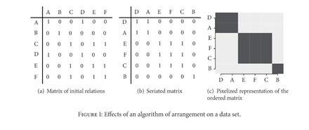
6. Visual Displays & Block models
Block Modeling
Matrix algebraic method for sorting network actors into jointly occupied, structurally equivalent positions
blockmodel
Partition of a sociomatrix of g actors into two or more discrete subgroups or positions called blocks (B).
Block refers to a square submatrix of structurally equivalent actors that have very similar relations with actors occupying the other block. It is a data reduction technique that systematically searches for relational patterns in network data

